Slide 1
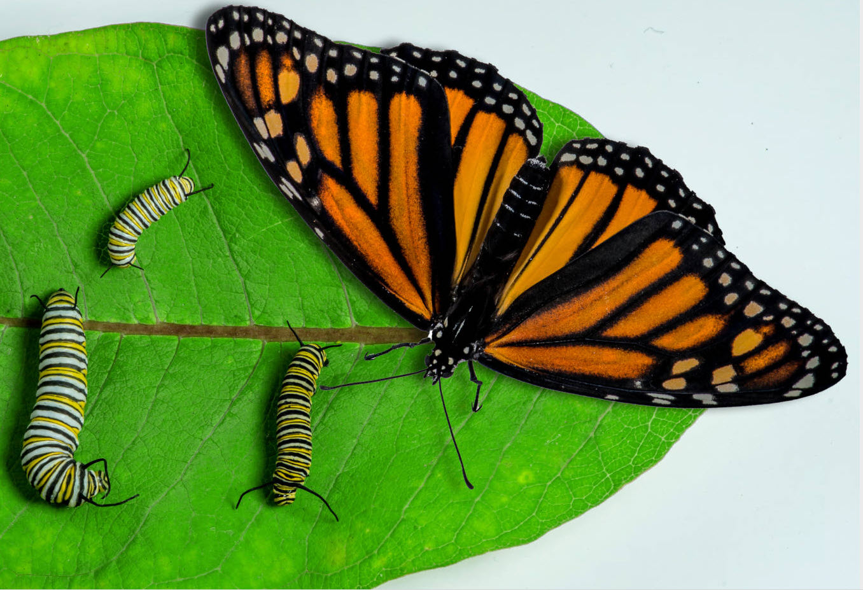
Part 3: Mistakes Evolutionists Make and Common Sense

Slide 2
Patent office
Rejects inventions that claim to violate a law of science.
Notes:
An honest scientist will reject theories that violate a known law of science. The theory of evolution violates 3 of them! You may not understand every detail of an invention or theory, but if you are sure it violates a know law of science, you can be sure that the invention or theory is false. In this presentation we are going to show you where people go wrong in concluding the theory of evolution is supported by the evidence. It is not.

Slide 3
Evolution violates laws of science:
Information is not created by chance.
2nd Law of Thermodynamics
– things move to less order
Chemistry
– prevents life from starting in nature
Notes:
Oxygen is the enemy of DNA, degrades it, just like it makes a nail or car rust. RNA is even more fragile than DNA.
Proteins could never form in water, because a well known process called hydrolysis would break them up. These are well known and experimentally verifiable facts of chemistry.

Slide 4
Mistakes Evolutionists Make
Believing explanations that violate proven laws of science
Ignoring the obvious – caterpillar to butterfly
Notes:
------ 2 Ignoring science that contradicts -→Information science – known fact that information does not happen by chance.
Law of abiogenesis – It is known that life does not spring from non-life
Entropy – Things move to a less organized state.
There are dozens of ways of estimating the age of the earth, sun, and planets. Most give ages far less than the billion of years claimed by evolutionists.++==
Each human generation has about 100 to 200 mutations from the prior.
Since almost all mutations are harmful or neutral, if there is an occasional good mutation, it still is greatly outnumbered by the bad.
And each succeeding generation accumulates more and more bad mutations. Our DNA is degrading.
---3----- False data -------Piltdown Man hoax, (jaw of orangutan put with skull of modern man) over 40 years before evolutionists could discover it, though famously studied as an ape to man transition fossil
Nebraska Man – pig’s tooth.
Whale – Rhodocetus – Univ Michigan Prof Gingerich constructed a fluke, when there was no fluke in the fossil found.
-Haeckel’s embryo diagram. Embryology recapitulates (repeats) ontology. In Roe vs. Wade, Justice Harry Blackmun, who wrote majority opinion, accepted Haeckel’s diagrams as part of his reasoning that the fetus was a non-citizen. But we now know that Haeckel’s diagram was wrong.
--4--- Lack of rigor - Subjective guesses ---Anyone who claims something is a transition fossil is only guessing. There is no scientific rigor to this. Whale fossils. Diagram frequently used is based on artists’ reconstructions. Rhodocetus now is not thought to have a fluke (whale tail). Prof Philip Gingerich was only guessing at this and has now changed his mind.
Puijila (pinniped or otter?) Claimed to be a transition from land animals to pinnipeds (seals, walrus, sea lion). However, the skeleton is virtually the same as a river otter’s.
Richard Dawkins interpreted Richard Lenski’s experiments with bacteria to mean evolution.
59 genes in two different tribes of bacteria had their levels of expression changed – remarkably all in the same direction.
Dawkins wrote – “exactly the kind of thing creationists say cannot happen”
It turned out that all 59 genes were controlled a single other gene – spoT. It was not 59 independent mutations. Dawkins sloppily failed to make a distinction between gene expression and gene information.
----5 -- if you extrapolate a little, you may still be correct. Extrapolating a lot is not science, guessing.
A baby roughly doubles its weight in 6 months. If it weighed 7 pounds at birth and doubled its weight every 6 months for 5 years, it would weigh 7,000 pounds at age 5.
(Can observe small changes in DNA. But producing new structures is entirely different. Requires huge leaps in complexity with many things happening at once. You might win money gambling one night. But it is unlikely you will ever win the Powerball lottery, and certain that you will not win it every time you play. Creating the groups of new proteins that are required for new structures requires producing many new things at the same time. Impossible. An eye functions or it doesn’t. It takes a very complex group of things to function. A circulatory system functions or it doesn’t. You have a backbone or don’t have one.
--6--- Lack of rigor - Insufficient data ----Can’t reproduce evolution in the lab. Supposedly need millions of years. So left to guess. Transitional fossils missing.
Liger = Male Lion + Female Tiger (is Fertile)
Wolphin = false killer whale + bottlenose dolphin (fertile)

Slide 5
Caterpillar to Butterfly?

Slide 6
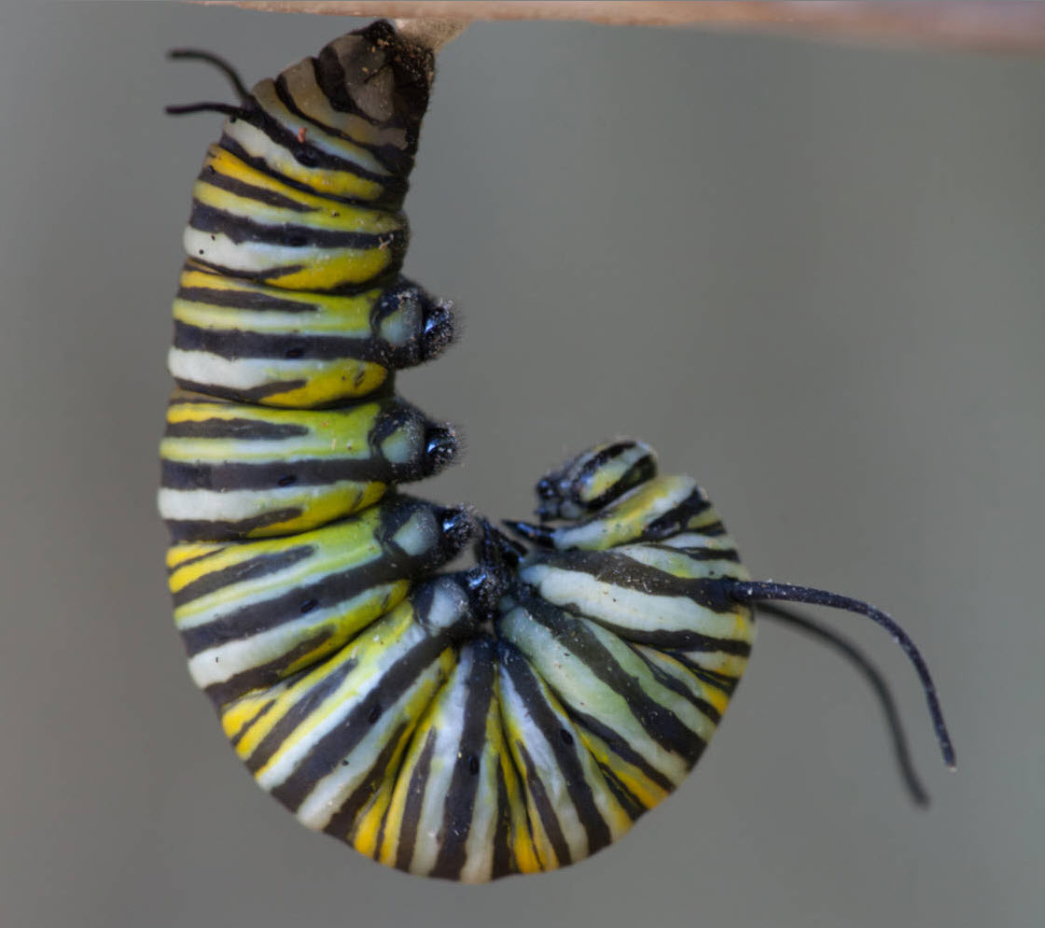
Starting to Shed Skin
Silk like
Attachment
Notes:
Butterfly caterpillars shed their skin and then proteins on their exterior harden to form a chrysalis.
(Moths are different, most moths spin a cocoon and their pupae live in the cocoons.)

Slide 7
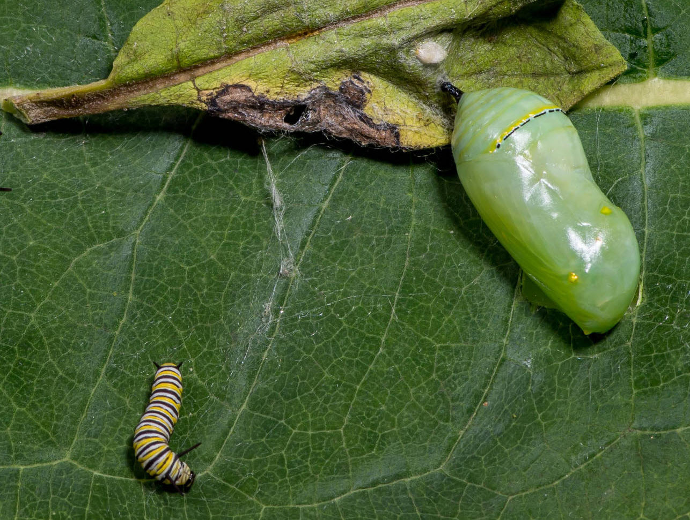
Chrysalis
Notes:
While in the chrysalis, except for a few things like the heart, the pupa dissolves and becomes a liquid mix of chemicals, which are re-used to construct the body of the butterfly. Truly a miraculous metamorphosis. This is not something that could happen by small gradual changes. But according to evolution, all the complexity of life happened by small gradual changes. It is common sense that this is not true. To believe in evolution is to reject common sense. It is dishonest.

Slide 8
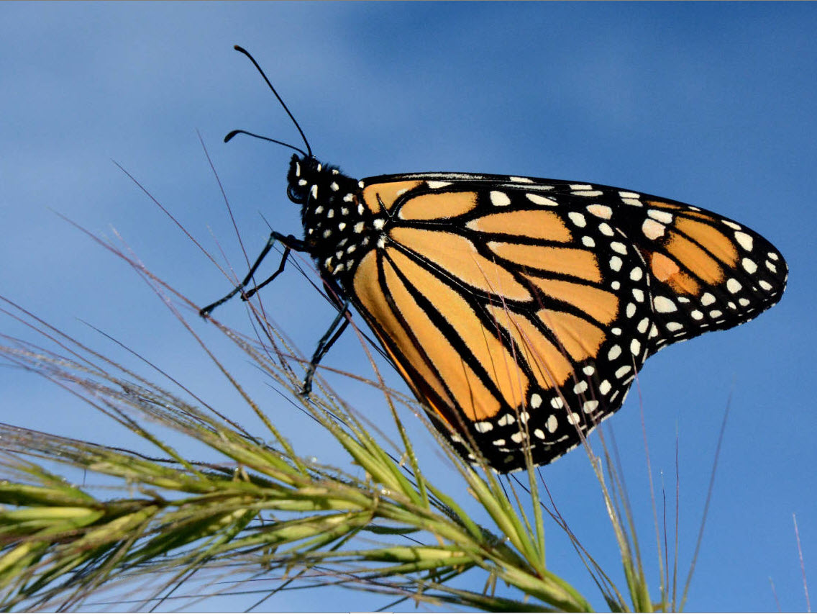

Slide 9
Mistakes Evolutionists Make
Believing explanations that violate proven laws of science
Ignoring the obvious – caterpillar to butterfly
Relying on subjective interpretations
– fossils, genetics, antibiotic resistance
Extrapolation
Lack of scientific rigor
- no provable change to new type
(mouse to bat)
Tiny changes
No complexity
→ Huge changes
Increased complexity
Notes:
--- Mike this one I think has latest updates.--- 2 Ignoring science that contradicts -→Information science – known fact that information does not happen by chance.
Law of abiogenesis – It is known that life does not spring from non-life
Entropy – Things move to a less organized state.
There are dozens of ways of estimating the age of the earth, sun, and planets. Most give ages far less than the billion of years claimed by evolutionists.++==
Each human generation has about 100 to 200 mutations from the prior.
Since almost all mutations are harmful or neutral, if there is an occasional good mutation, it still is greatly outnumbered by the bad. Most mutations are nearly neutral, only slightly bad, and cannot be removed by natural selection. This means that each succeeding generation accumulates more and more bad mutations. Our DNA is degrading. In the last 6,000 years the lifespan of mankind has grown smaller. There has been a temporary improvement in modern nations due to improved medical care and nutrition. But eventually mankind will go extinct. Leading secular population geneticists are aware of the problem.
---3----- False data -------Piltdown Man hoax, (jaw of orangutan put with skull of modern man) over 40 years before evolutionists could discover it, though famously studied as an ape to man transition fossil
Nebraska Man – pig’s tooth.
Whale – Rhodocetus – Univ Michigan Prof Gingerich constructed a fluke, when there was no fluke in the fossil found.
-Haeckel’s embryo diagram. Embryology recapitulates (repeats) ontology. In Roe vs. Wade, Justice Harry Blackmun, who wrote majority opinion, accepted Haeckel’s diagrams as part of his reasoning that the fetus was a non-citizen. But we now know that Haeckel’s diagram was wrong.
--4--- Lack of rigor - Subjective guesses ---Anyone who claims something is a transition fossil is only guessing. There is no scientific rigor to this. Whale fossils. Diagram frequently used is based on artists’ reconstructions. Rhodocetus now is not thought to have a fluke (whale tail). Prof Philip Gingerich was only guessing at this and has now changed his mind.
Puijila (pinniped or otter?) Claimed to be a transition from land animals to pinnipeds (seals, walrus, sea lion). However, the skeleton is virtually the same as a river otter’s.
Richard Dawkins interpreted Richard Lenski’s experiments with bacteria to mean evolution.
59 genes in two different tribes of bacteria had their levels of expression changed – remarkably all in the same direction.
Dawkins wrote – “exactly the kind of thing creationists say cannot happen”
It turned out that all 59 genes were controlled a single other gene – spoT. It was not 59 independent mutations. Dawkins sloppily failed to make a distinction between gene expression and gene information.
----5 -- if you extrapolate a little, you may still be correct. Extrapolating a lot is not science, guessing.
A baby roughly doubles its weight in 6 months. If it weighed 7 pounds at birth and doubled its weight every 6 months for 5 years, it would weigh 7,000 pounds at age 5.
(Can observe small changes in DNA. But producing new structures is entirely different. Requires huge leaps in complexity with many things happening at once. You might win money gambling one night. But it is unlikely you will ever win the Powerball lottery, and certain that you will not win it every time you play. Creating the groups of new proteins that are required for new structures requires producing many new things at the same time. Impossible. An eye functions or it doesn’t. It takes a very complex group of things to function. A circulatory system functions or it doesn’t. You have a backbone or don’t have one.
--6--- Lack of rigor - Insufficient data ----Can’t reproduce evolution in the lab. Supposedly need millions of years. So left to guess. Transitional fossils missing.
Liger = Male Lion + Female Tiger (is Fertile)
Wolphin = false killer whale + bottlenose dolphin (fertile)

Slide 10
Creation vs. Evolution
27% of Americans with college degrees believe that God created humans pretty much the way they are now
(2014 Gallup poll)
Science is not based on majority opinion

Slide 11
Give your own presentations.
Free downloads of Powerpoints used in these videos at:
Educate7.com
How7.org
Are You an Accident of Nature?

Slide 12
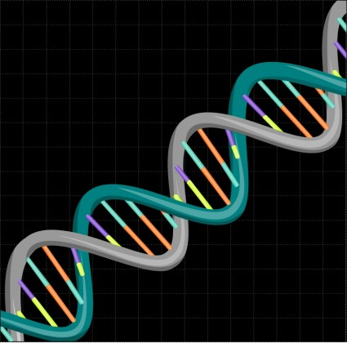
Next:
Are You an Accident of Nature?
Part 4
No information by chance -
DNA
Drawing by
Gustavo Rezende

